Slide 1

Lime Instruction Set Architecture
Luke, Naziia, Tulsi, Yueqiao,
CSSE 232 | CSSE Department
Rose-Hulman Institute of Technology

Slide 2
Highlight
Design
Unified Control Unit
Innovative Immediate Handling
Comprehensive Instruction Support
Future-Ready Extendibility
16-Bit Architecture
Special UI Register for imm
Use
Advanced Assembler (Online + Local)
AI Instruction Assistant
RelPrime Runtime:
2.13 ms
CLK freq: 91.19Mhz
Cycle: 194113
Notes:
Unified Control Unit: Our architecture is centered around a streamlined, single control unit, optimizing instruction decoding and execution for efficiency and simplicity.
Innovative Immediate Handling: We've implemented a special mechanism for immediate values, enhancing our processor's ability to handle a wide range of operations directly and efficiently.
Comprehensive Instruction Support: The design supports a core set of essential commands, meticulously selected to meet the global needs of computing applications, laying the foundation for a versatile general-purpose CPU.
Future-Ready Extendibility: Designed with forward-thinking adaptability, our architecture allows for seamless integration of future enhancements and capabilities.
16-Bit Architecture: Currently supporting up to 16 bits, our design ensures compatibility with a broad spectrum of applications, from simple control systems to more complex computational tasks.

Slide 3
Instruction Design

Slide 4
What is Lime
Load Store Architecture
Eight 16 Bit Registers
Branches are PC relative while jumps use absolute addressing
16 bit memory adressing with special adresses reserved for input/output
Large instruction set with 5 diferent instruction types are room for 3 more in future development

Slide 5
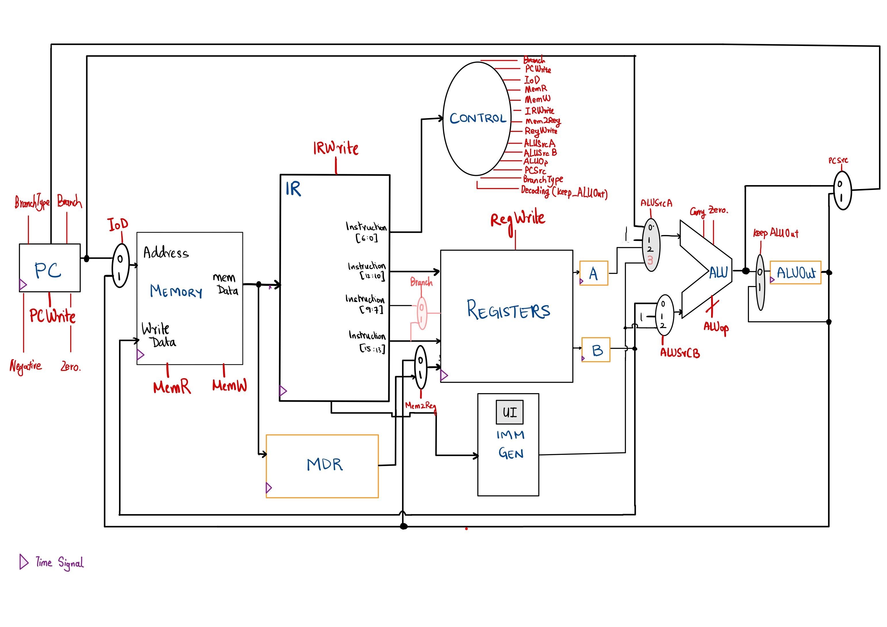
Datapath

Slide 6
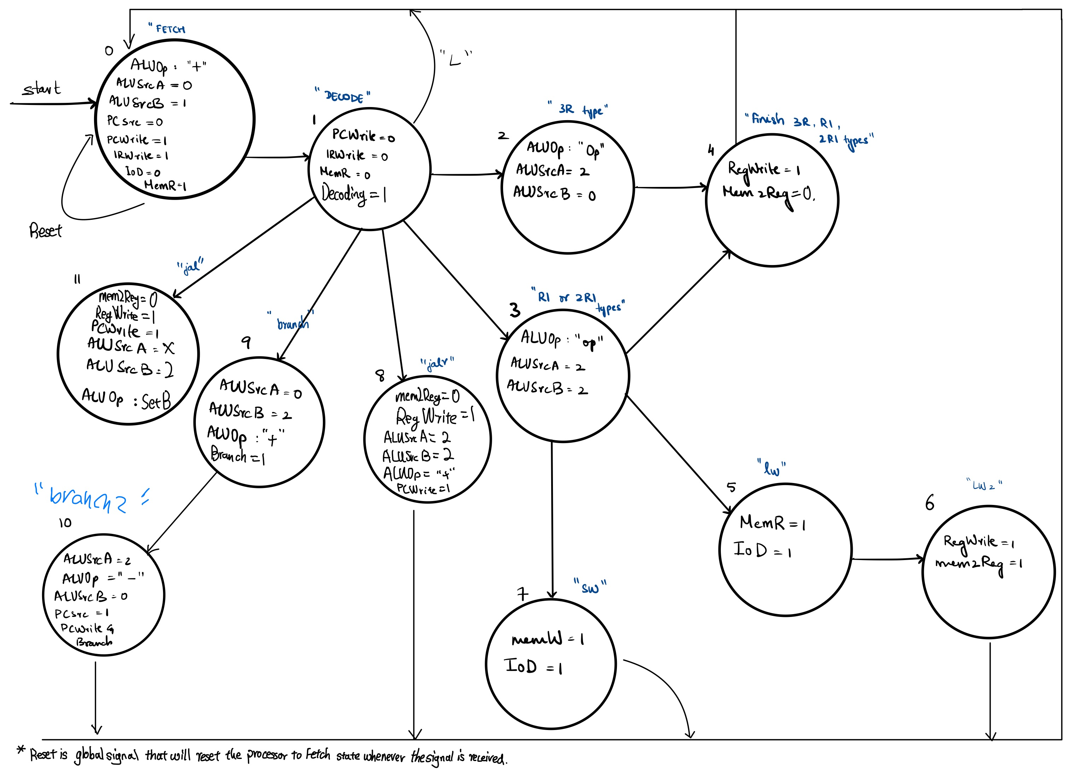
Control State

Slide 7
Multi Cycle RTL
Cycles | 3R-Type | RI-Type | 2RI-Type | lw/sw | jalr | Branch | jal | lui
1 | PC = ALU(+, PC, 1) IR = Mem([PC]) ALUOut = ALU(+, PC, 1) |  |  |  | PC = ALU(+, PC, 1) IR = Mem([PC]) ALUOut = ALU(+, PC, 1)
2 | A = Reg[IR[12:10]] B = Reg[IR[9:7]] ALUOut = ALUOut |  |  |  | A = Reg[IR[12:10]] B = Reg[IR[9:7]] ALUOut = ALUOut
3 | ALUOut = ALU(ALUOp, A, B) | ALUOut = ALU(ALUOp, A, IG([9:7])) |  |  | Reg(IR[15:13]) = ALUOut PC = ALU(+, A, IG([9:7]) ) | A = Reg[IR[12:10]] B = Reg[IR[15:13]] ALUOut = ALU(+, PC, IG([9:7])) | Reg[IR[15:13]]=ALUOut PC = ALU( IG([12:3]) )
4 | 4) Reg[IR[15:13]] = ALUOut |  |  | lw: MDR = Mem[ALUOut] sw: Mem[ALUOut] = Reg(IR[15:13]) |  | If (A branchType B) PC = ALUOut
5 |  |  |  | lw: Reg(IR[15:13]) = MDR

Slide 8
Instruction Format
15 | 14 | 13 | 12 | 11 | 10 | 9 | 8 | 7 | 6 | 5 | 4 | 3 | 2 | 1 | 0
rd |  |  | r1 |  |  | r2 |  |  | func 4 |  |  |  | opcode |  |  | 3R type
imm [ 12 : 0 ] |  |  |  |  |  |  |  |  |  |  |  |  | opcode |  |  | L type with a special register
rd |  |  | r1 |  |  | imm [ 2 : 0 ] |  |  | func 4 |  |  |  | opcode |  |  | 2RI type
rd |  |  | imm [ 9 : 0 ] |  |  |  |  |  |  |  |  |  | opcode |  |  | UJ type
rd |  |  | imm [ 5 : 0 ] |  |  |  |  |  | func 4 |  |  |  | opcode |  |  | RI type

Slide 9
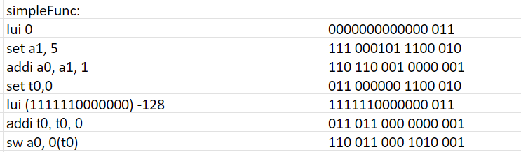
Code Snippets

Slide 10
Immediate handling
Immediates are handled very differently for each instruction type in order to maximize the small size of our 16 bit instructions.
2RI instructions such as addi append the three bit immediate to 12 bits added to the special Upper Immediate Register in a prior lui instruction
RI instructions such as set have a 6 bit immediate that is sign extended
UJ instructions have a 10 bit immediate so they can jump anywhere in memory

Slide 11
Challenges
Clock Edge
Timing of Data
They arrive at different time
Added something even yesterday

Slide 12
Relprime Assembly Example
set t0, 0
lui (1111110000000) -128
lw a0, 0(t0)
relPrime: lui 0
subi sp, sp, 4
sw ra, 0(sp)
sw a0, 1(sp)
set a1, 2
sw a1, 2(sp)
loop: jal ra, gcd
set t2, 1
beq a0, t2, exit_loop
lw a0, 1(sp)
lw a1, 2(sp)
addi a1, a1, 1
sw a1, 2(sp)
jal t0, loop
exit_loop: lw a1, 2(sp)

Slide 13
Relprime Assembly Example continued
addi a0, a1, 0
lw ra, 0(sp)
lui (1111110000000) -128
addi sp, sp, 4
set t0, 0
sw a0, 0(t0)
gcd: set s0, 0
sw ra, 3(sp)
bne a0, s0, gcd_loop
addi a0, a1, 0
jalr t0, 0(ra)
gcd_loop: beq a1, s0, gcd_end
beq a0, a1, goto 0x001F
bge a0, a1, greater
sub a1, a1, a0
jal t0, gcd_loop
greater: sub a0, a0, a1
jal t0, gcd_loop
gcd_end: lw ra, 3(sp)
jalr t0, 0(ra)

